Slide 1


Instituto Universitario de Ciencias y Tecnologías Espaciales de Asturias (ICTEA)
Efficiency estimations
17th September 2024
Sara Rodríguez Cabo et al

Slide 2
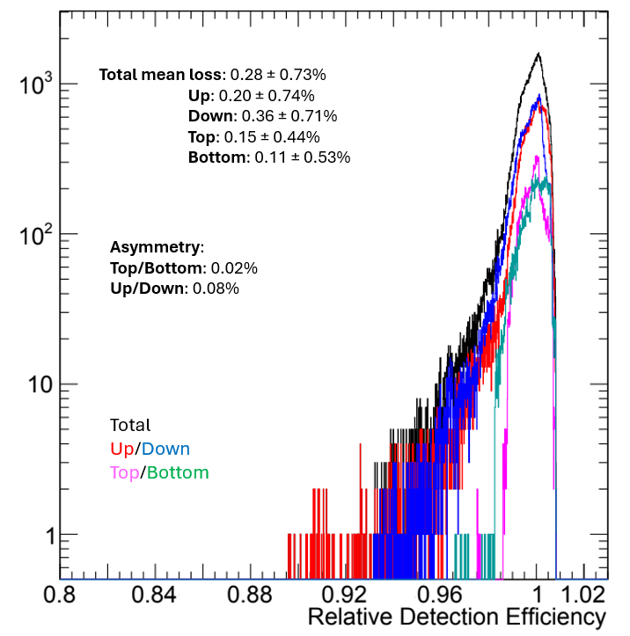
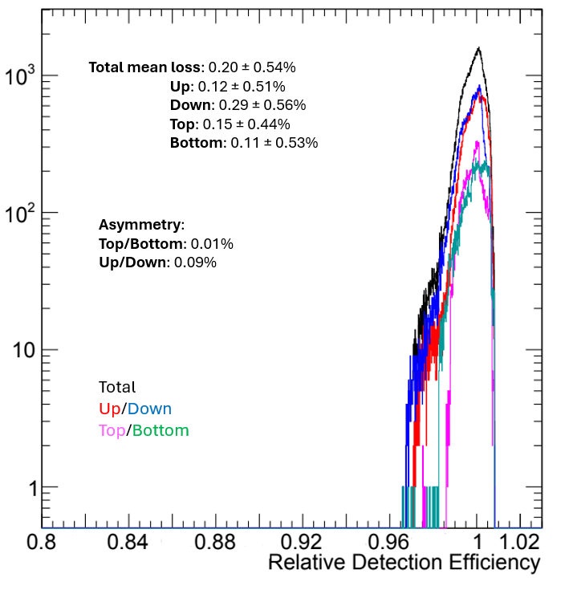
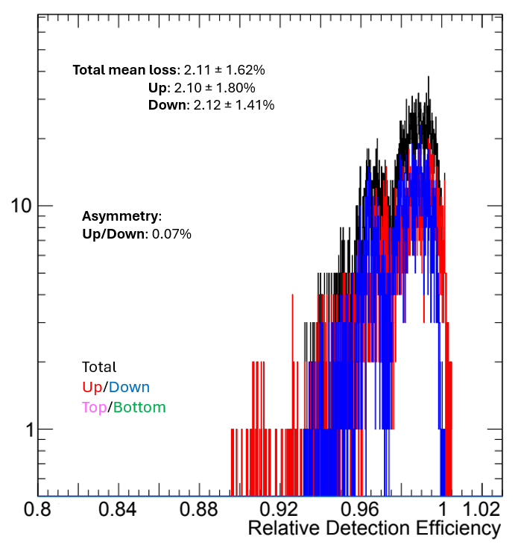
1. Average case
All PMTs
PMTs compensated
PMTs with excess
Loss of efficiency | 1% | 2% | 3% | 5% | 10%
All | 9.86% | 2.77% | 1.15% | 0.23% | 0
Compensated | 7.26% | 1.10% | 0.06% | 0% | 0
With excess | 71.97% | 42.57% | 27.20% | 5.63% | 0.08%

Slide 3
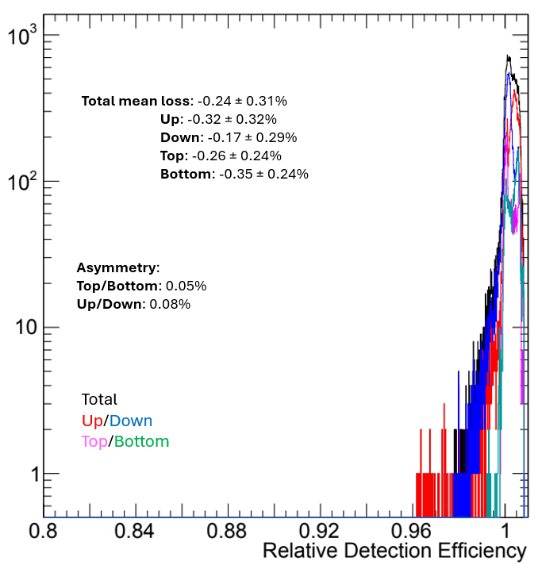
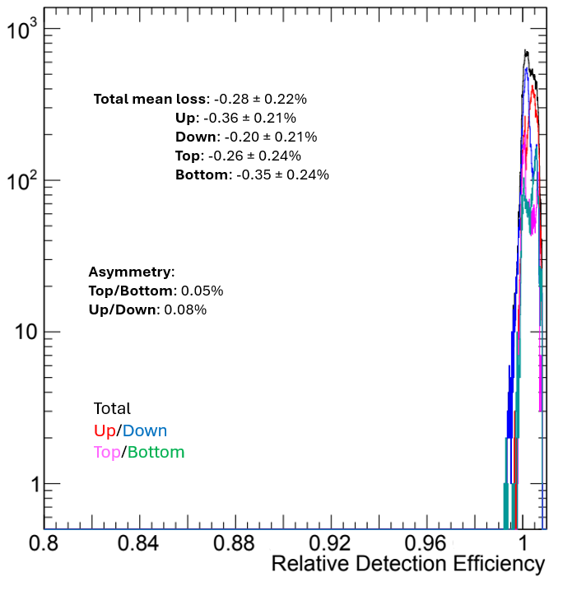
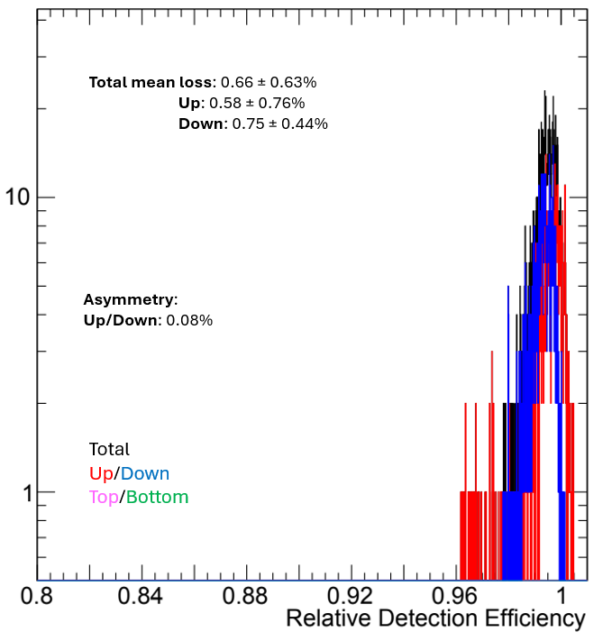
2. Best case
All PMTs
PMTs compensated
PMTs with excess
Loss of efficiency | 1% | 2% | 3% | 5% | 10%
All | 0.86% | 0.15% | 0.06% | 0% | 0%
Compensated | 0% | 0% | 0% | 0% | 0%
With excess | 21.39% | 3.81% | 1.5% | 0% | 0%

Slide 4
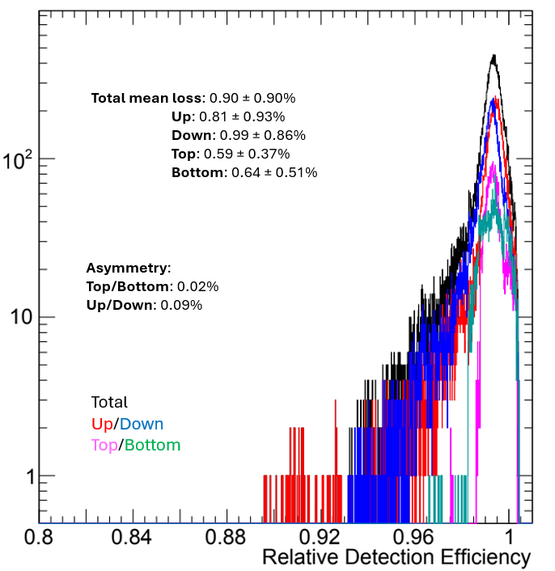
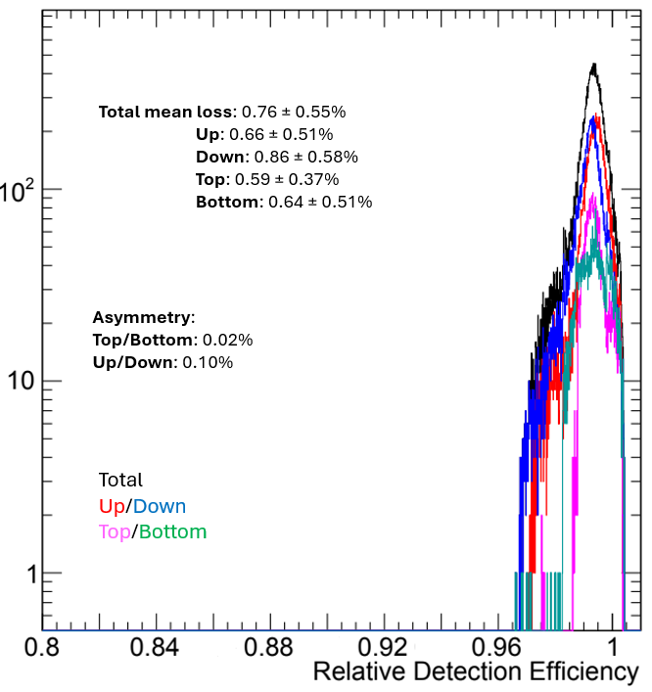
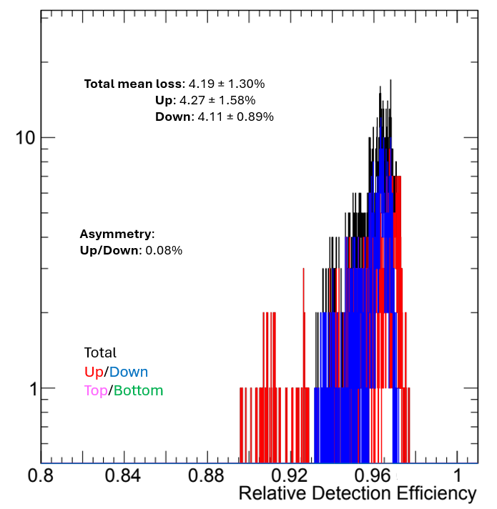
3. Worst case
All PMTs
PMTs compensated
PMTs with excess
Loss of efficiency | 1% | 2% | 3% | 5% | 10%
All | 26.69% | 8.20% | 3.82% | 0.80% | 0.01%
Compensated | 23.63% | 4.36% | 0.22% | 0% | 0%
With excess | 100% | 100% | 89.87% | 19.89% | 0.31%

